Slide 1


Box Office SUCCESS PREDICTOR
Team 12 : CMPE 255, Sec 2
Nitsimran Singh : 015929394 Saikrishna Dosapati : 015929394
Fayzali Mulla: 015929394
Sachith Gandham: 015929394

Slide 2
Introduction and Related Work

Slide 3
Problem Statement
It is wise to have a prediction before a monetary investment has been made, which is what we are trying to achieve.
•Movie success prediction is an important problem domain because it is an expensive task to a movie.
•Movie success prediction can help prevent this problem by utilising data mining techniques to predict a movies success ahead of its time. This will help the people making the movie make a decision, based on its success prediction.
•The audience can also know the quality and success of the movie before actually spending money on watching it.

Slide 4
Introduction
•The goal of our project is to predict a movie’s success or failure by analysing existing movies database with its reviews and also the data related to the cast and crew associated and their movies in the past.
•Data mining techniques are applied to the movies data set in order to extract patterns and identify trends that will help us in predicting a movies success.
•We will compute the accuracy of our predictions with several models(KNN, Naive Bayes, Random Forest, Logistic Regression and SVM) run on different combinations of the attributes to see how certain attributes affect the performance of the model.

Slide 5
Related Work
•Some of the earlier work categorised movies as a failure or success based on the revenue. Apart from revenue, there are other factors like cast and crew, genre, audience rating etc. that have an impact on the success.
•There were some experiments with analysing news data to make predictions. It was proved that news data was almost as good as IMDB data.
•More research was done to predict the investment decisions in the movie.
•People also tried to predict the success based on the social media hype by calculating the positivity in the comments, number of likes etc.

Slide 6
Method

Slide 7
Datasets
•Rotten Tomato Data set for movies
–Movies are divided into categories
–16,638 movies with various attributes such as Directors, actors, etc.
–Critic review data set includes 930,942 reviews of all the movie
•IMDB Dataset of 50K Movie Reviews
–The data consists a set of 25,000 highly polar movie reviews for training and 25,000 for testing

Slide 8
Approach
• Naive Bayes Classifier for sentiment analysis.
•Data Preprocessing
–One-hot Encoding and Multi Label Binarization
–Removal of Attributes
–Removal of Skewness and Outliers
–Oversampling

Slide 9
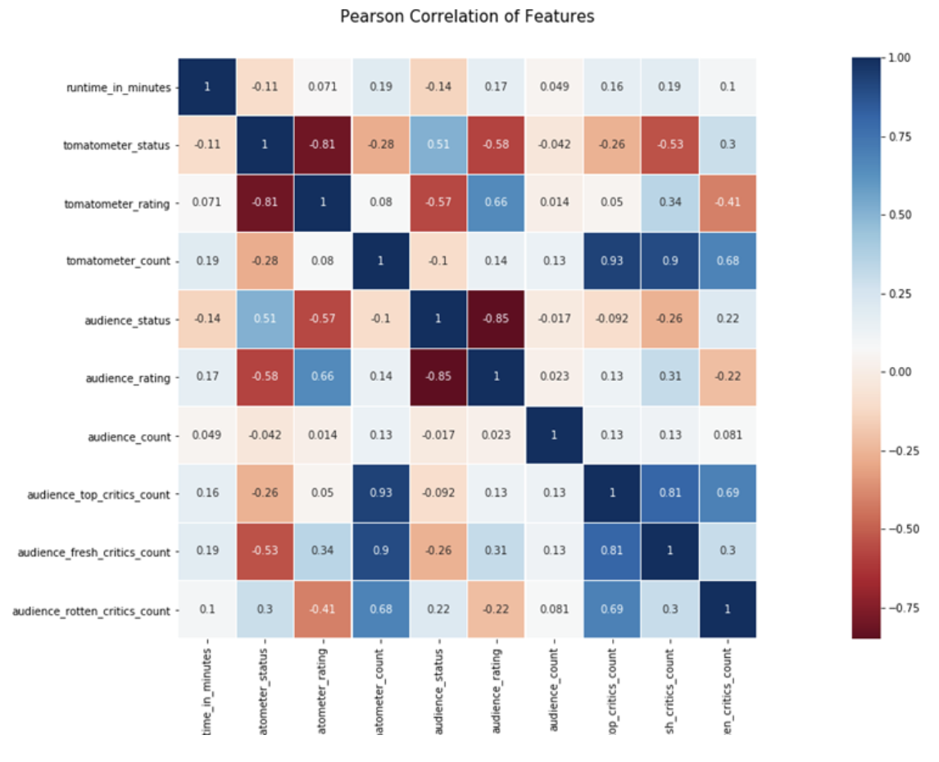
Data Preprocessing
Removal of Attributes - tomatometer_status, audience_status, audience_rating

Slide 10
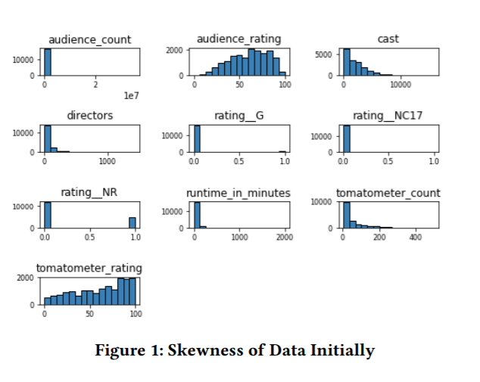
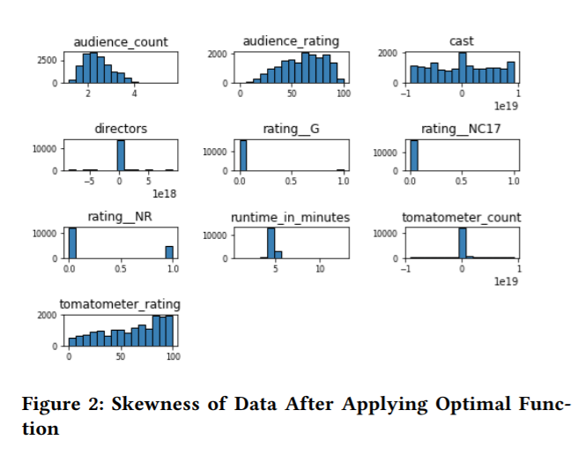
Data Preprocessing
Removal of Skewness and Outliers

Slide 11
Models
•Classifiers trained with cross validation
–KNN
–Naïve Bayes
–Random Forest
–Logistic Regression
–Support Vector Machines

Slide 12
Experimental Design and Results

Slide 13
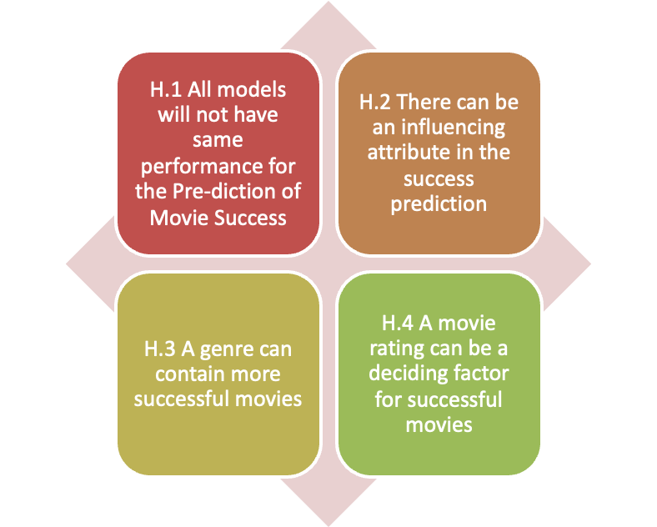
Hypothesis

Slide 14
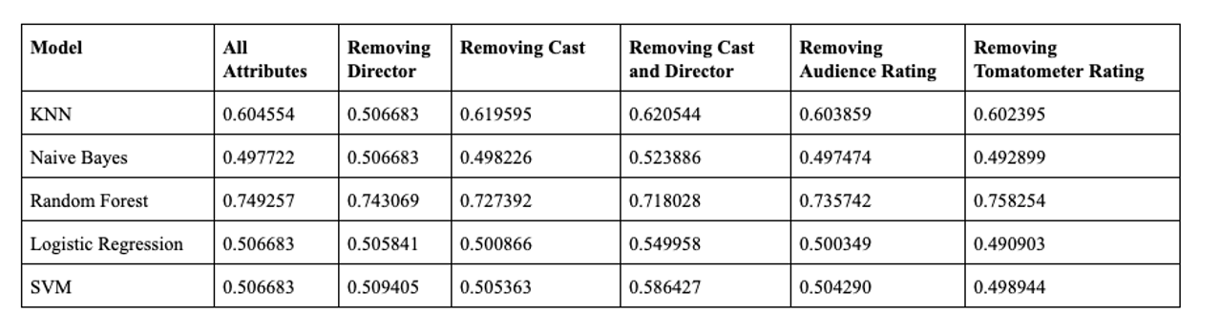
Cross Validation Results and Discussion of various Models
•The following are the results for cross validation accuracy for various models and for various attribute Combinations

Slide 15
Machine Learning Model Results
Model | Train Accuracy | Test Accuracy
KNN | 0.7547344 | 0.527687
Naïve Bayes | 0.505693 | 0.507892
Random Forest | 1.0 | 0.673515
Logistic Regression | 0.503960 | 0.513655
SVM | 0.515843 | 0.451265
•These are the results for various models including all the movie data attributes

Slide 16
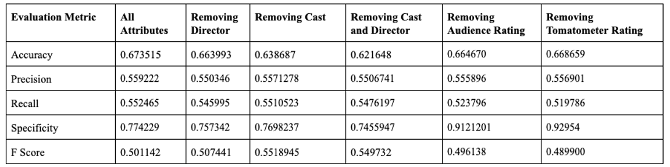
Evaluation Metric for various Attributes Combinations
•The following are the results for the Random Forest model for seeing the influence of various features.

Slide 17
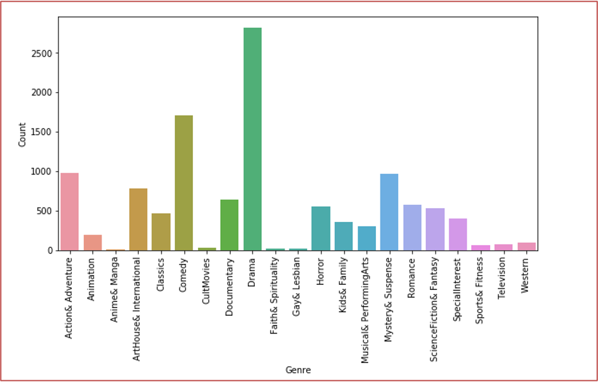
Movie Genre Success Count

Slide 18
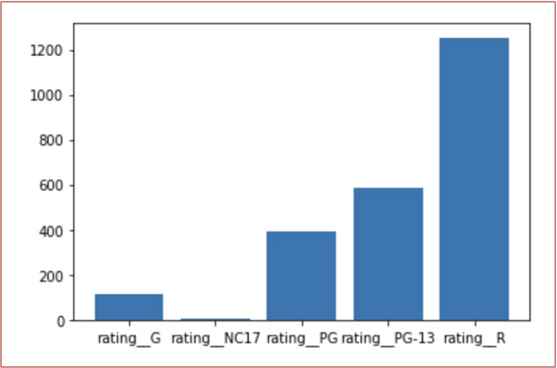
Movie Rating Success Count
Movie Rating Success Count

Slide 19
Discussion

Slide 20
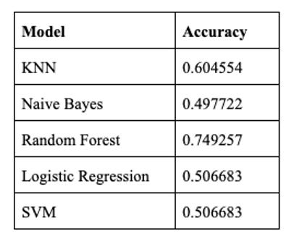
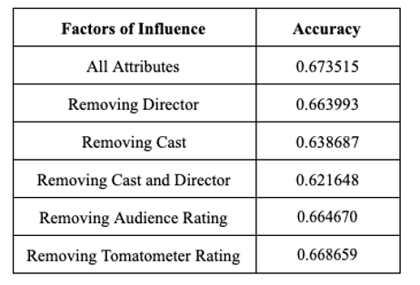
Evaluation Models and Factors
•The following are the results for cross validation accuracy for various models, it is visible that Random Forest is the right models for the movie data set : H.1
•It can also be seen that the attributes audience rating and tomato-meter rating influence the accuracy more than other combinations : H.2

Slide 21
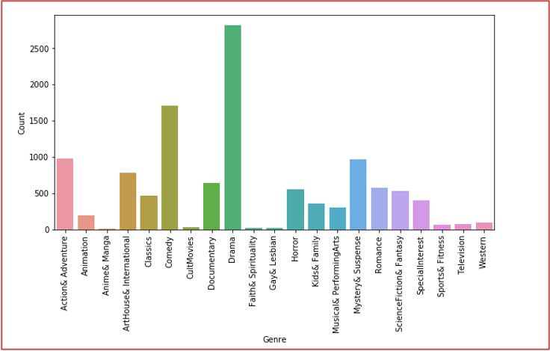

Most Successful Genre and Rating
•Drama is the most successful Genre : H.3
•R Rating movies are most successful : H.4

Slide 22
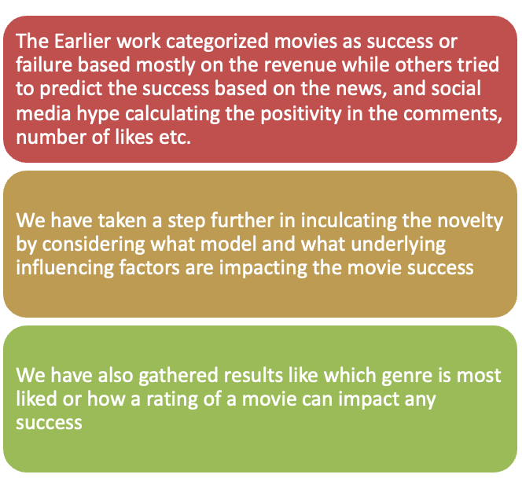
Conclusions and Contributions

Slide 23
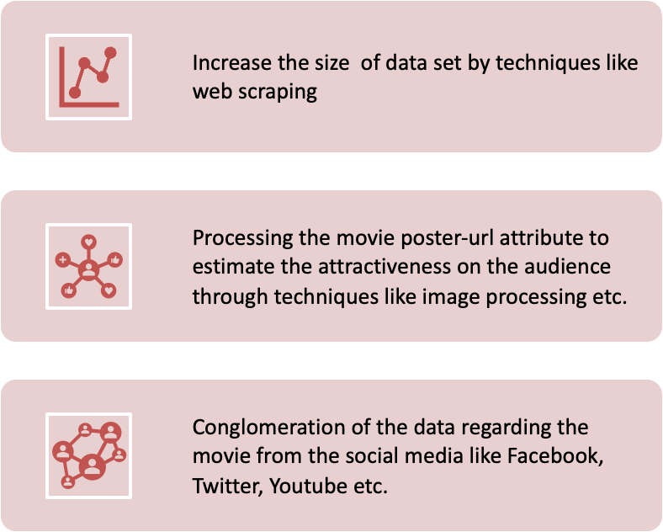
Future Work

Slide 24

Thank You

